Slide 1
What is signal?

Slide 2
What is signal?
Time-varying voltage, current or electromagnetic waves that carry information
Analog or digital representations of analog physical quantities
Analog signal: a continuous value in which a time varying quantity (i.e. voltage, pressure, etc…) represents another time-based variable – one variable is an “analog” of the other.
Dimmer switch connected to a light bulb. The dimmer has an infinite number of positions from off and full – and a corresponding infinite number of output from the light bulb
Digital signal: express the variation in discrete values.
More like an “on/off” switch.
Most analog signal is converted to a digital form so that it can be transmitted, stored, or processed.

Slide 3
Simple Transducer Circuit
Analog to Digital Converter
Signal
Tranducer
Amplifier
Readout
1 2 3 4 5 6
Current = i
k*i
v = f(i)
Number

Slide 4
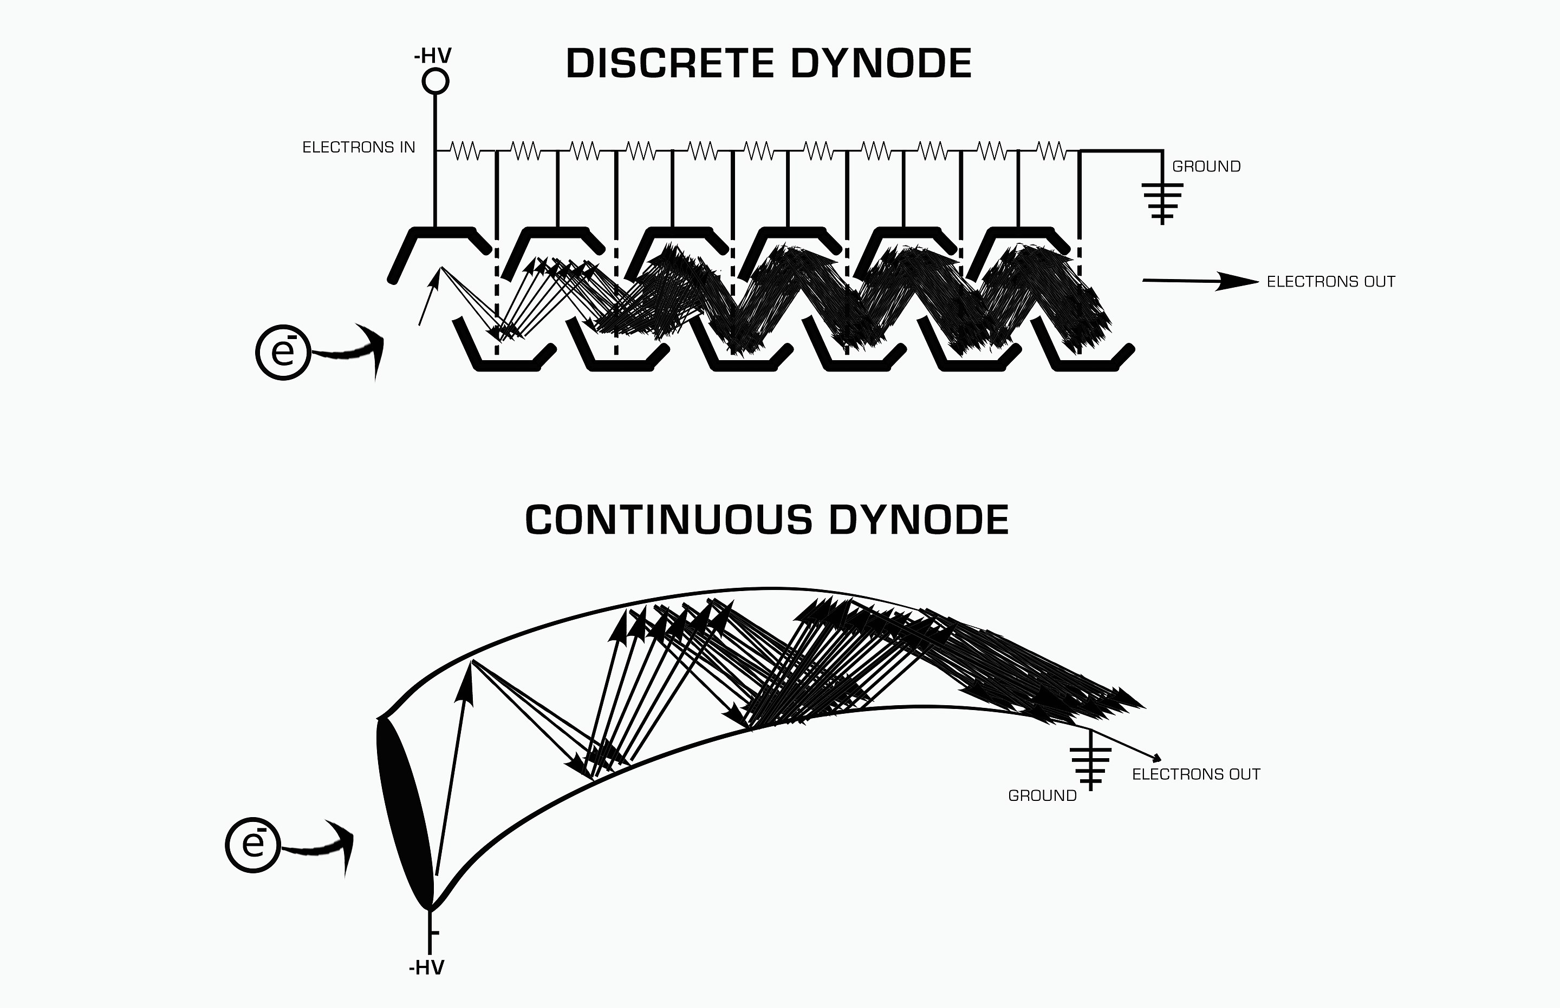
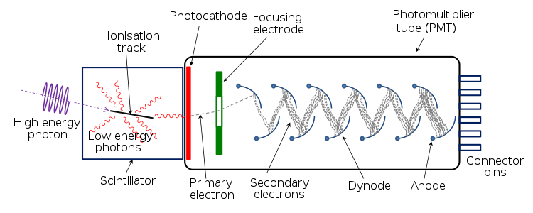
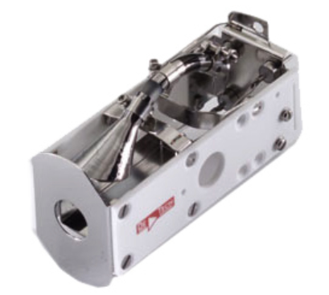
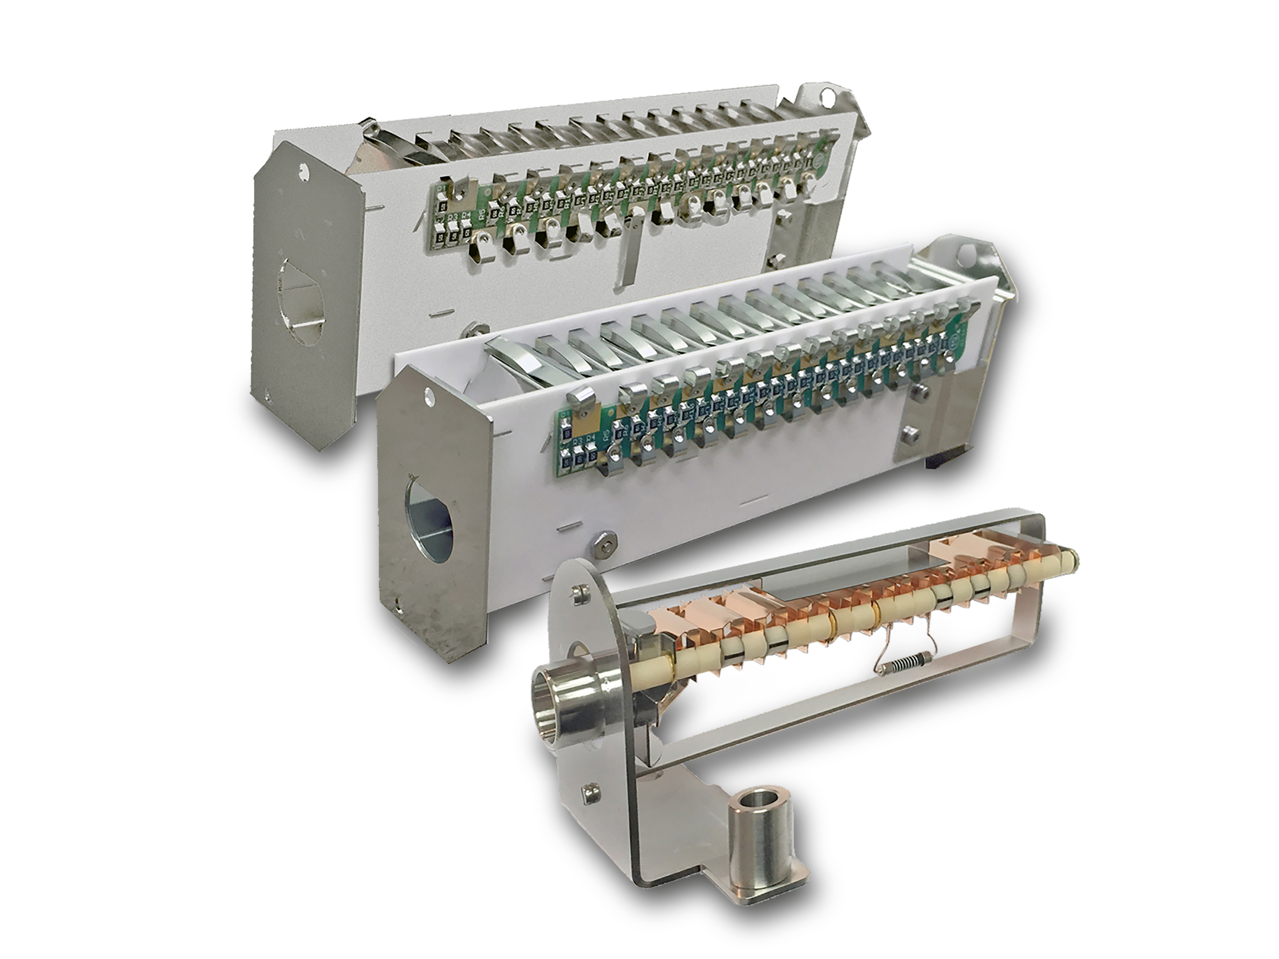
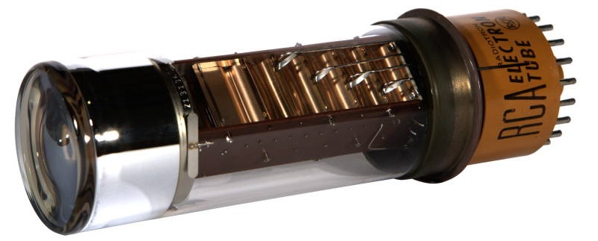
Transducers are similar for photons and ions
Photomultiplier Tube
Electron Multiplier

Slide 5
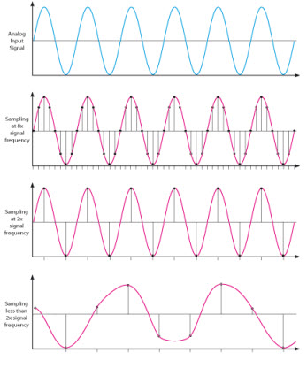
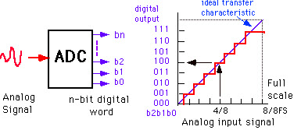
Important aspects of ADCs (digital conversion)
Sampling Rate
How fast the ADC can convert the signal?
Bit resolution
How much accuracy can the ADC convert from analog to digital?
3-bit ADC can provide 2³ divisions (8) in signal
8-bit ADC = 256 division
16-bit ADC = 65536

Slide 6
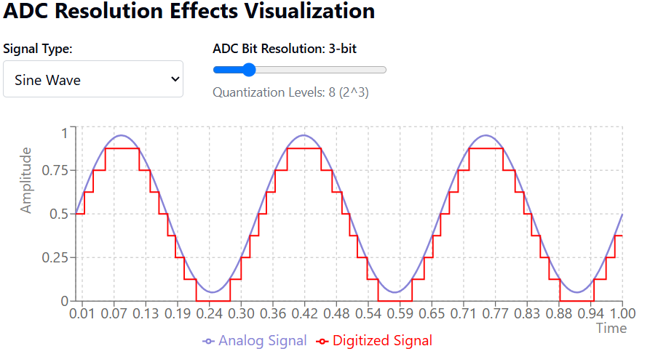
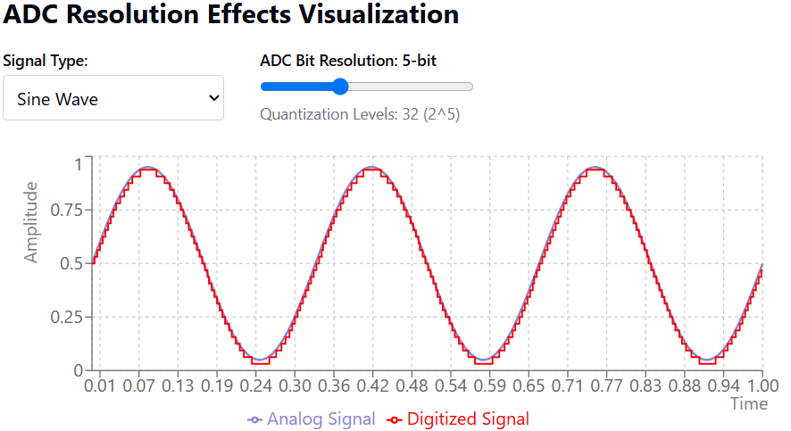
ADC Bit Resolution
https://claude.site/artifacts/47f9c1a3-6103-4c80-8746-e5797836833c

Slide 7
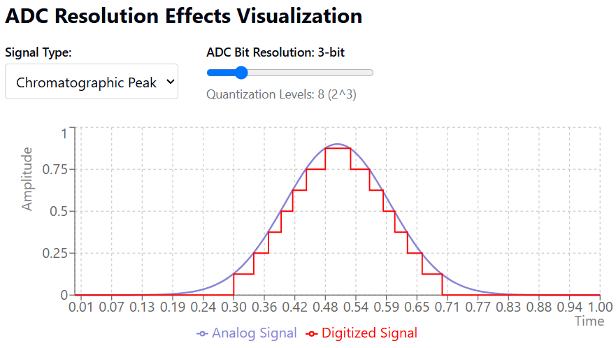
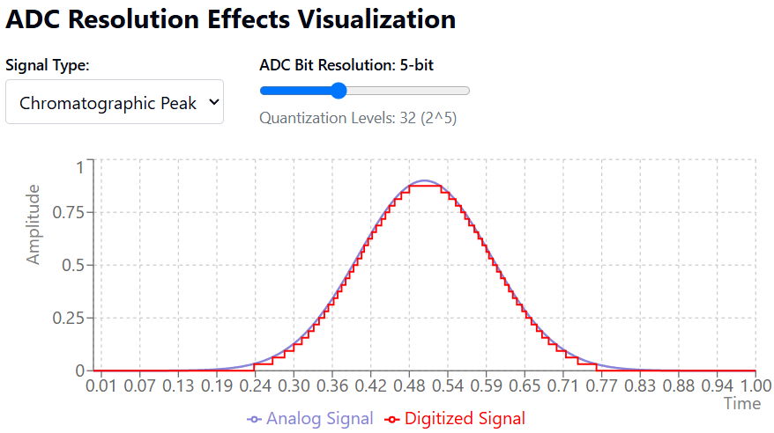
ADC Bit Resolution
https://claude.site/artifacts/47f9c1a3-6103-4c80-8746-e5797836833c

Slide 8
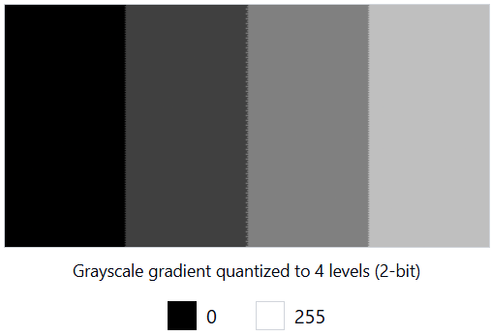
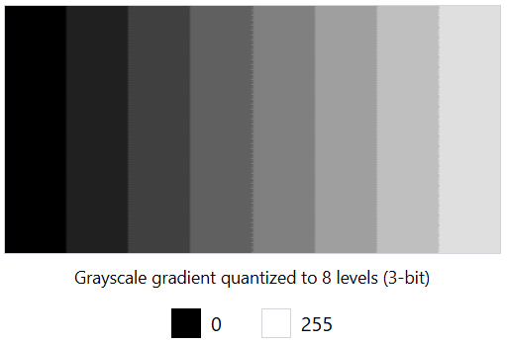
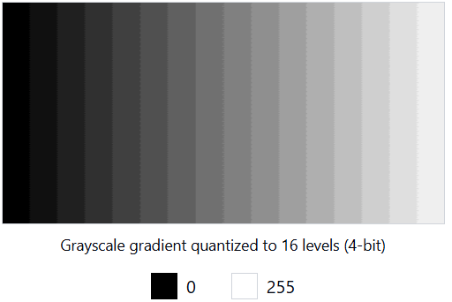
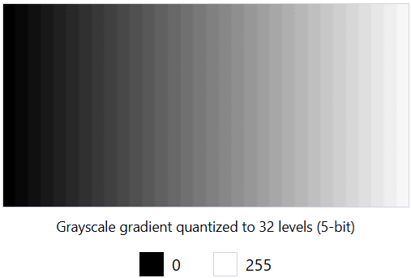
ADC Bit Resolution

Slide 9
What is noise?
Unwanted signals that obscure or interfere with the true, meaningful signal being measured.

Slide 10
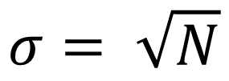
Types of Noise
Johnson noise (aka Thermal noise): noise from the thermal motion of electrons in the electronics. Constant and independent of the measured signal. Dependent on temperature and resistance in the electronics. Can be limiting factor at very high sensitivity measurements. Homoscedastic
Shot noise (aka Poisson noise, counting noise): Random variations in electron or ion motion lead to random variations in current. The higher the current, the larger the shot noise. Heteroscedastic
$$σ= \sqrt{N}$$

Slide 11
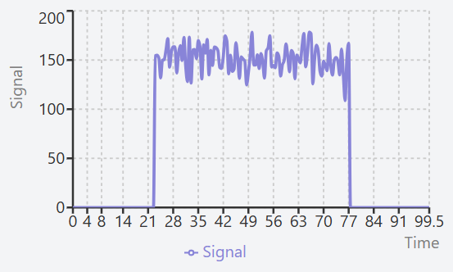
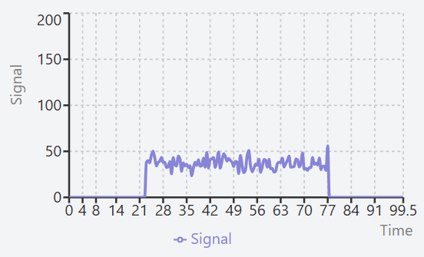
Types of Noise
Heteroscedastic noise – Signal dependent noise
https://claude.site/artifacts/224c911e-6b54-42bf-9804-114fa3104d3e

Slide 12
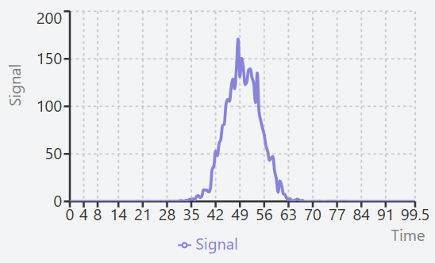
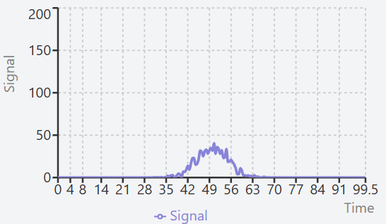
Types of Noise
Heteroscedastic noise – Signal dependent noise
https://claude.site/artifacts/224c911e-6b54-42bf-9804-114fa3104d3e

Slide 13
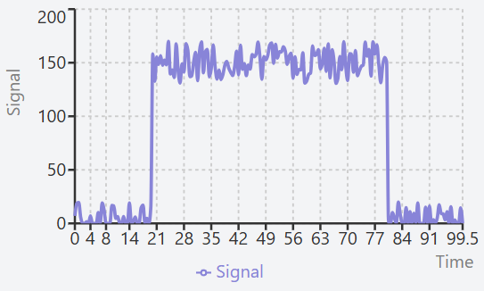
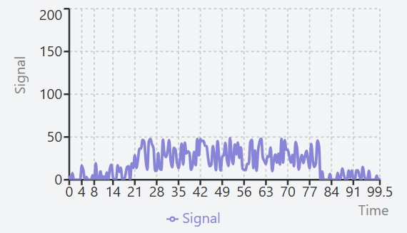
Types of Noise
Homoscedastic noise – Signal independent noise
https://claude.site/artifacts/224c911e-6b54-42bf-9804-114fa3104d3e

Slide 14
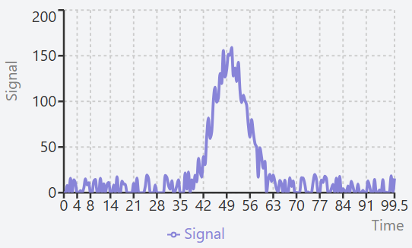
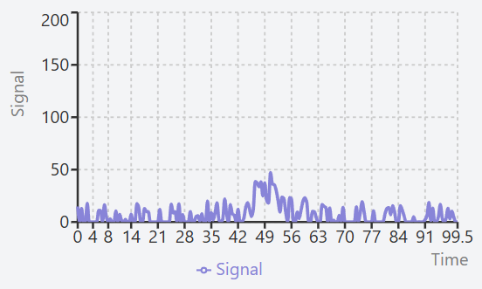
Types of Noise
Homoscedastic noise – Signal independent noise
https://claude.site/artifacts/224c911e-6b54-42bf-9804-114fa3104d3e

Slide 15
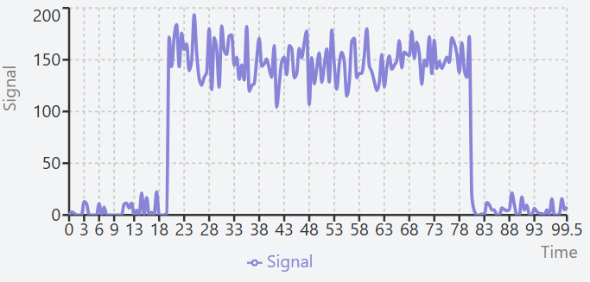
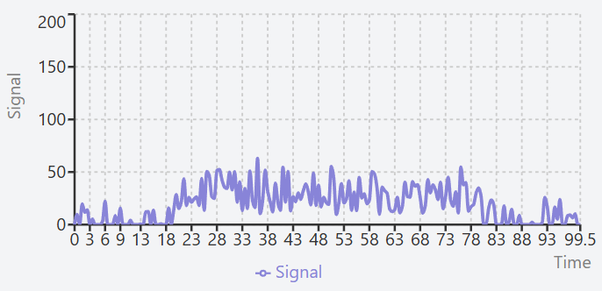
Both exist at the same time but from unknown amounts

Slide 16
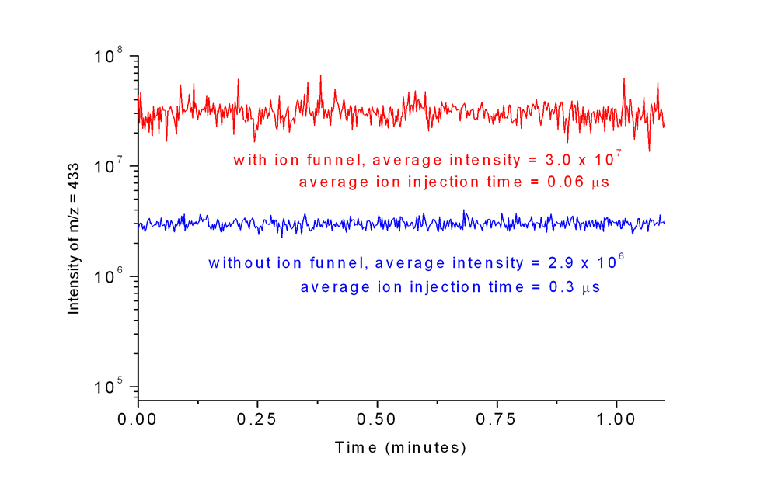
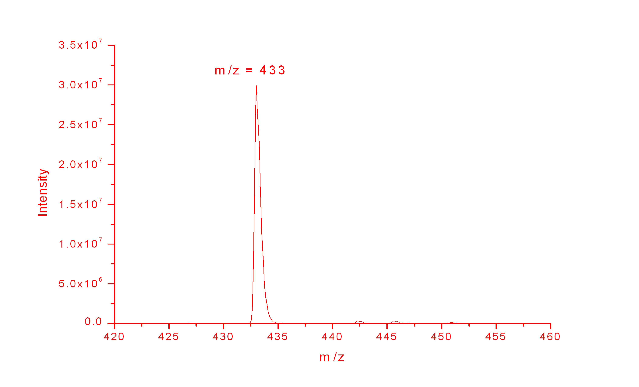
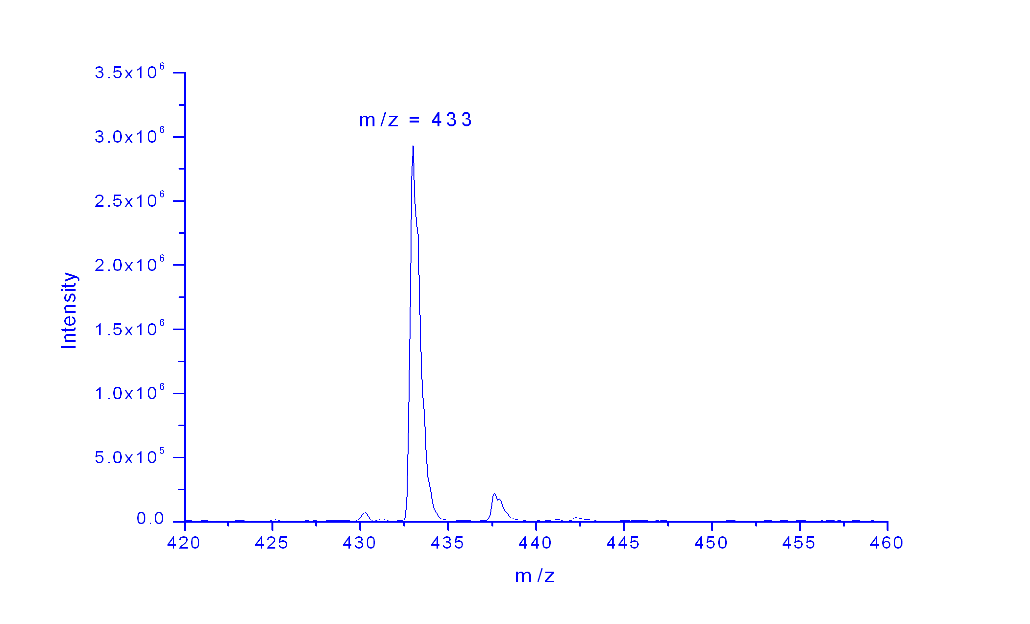
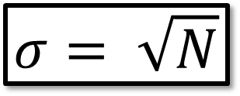
Shot Noise
~10x Improvement in Signal
~3x Improvement in S/N
$$σ= \sqrt{N}$$

Slide 17
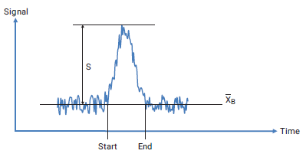
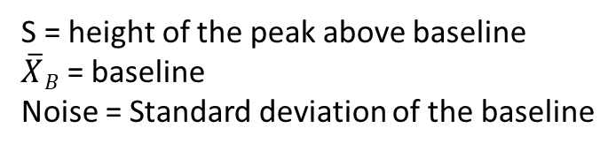
Ways to express Signal to Noise?
Most Common Way
S = height of the peak above baseline
$\overline{X}B$ = baseline
Noise = Standard deviation of the baseline

Slide 18
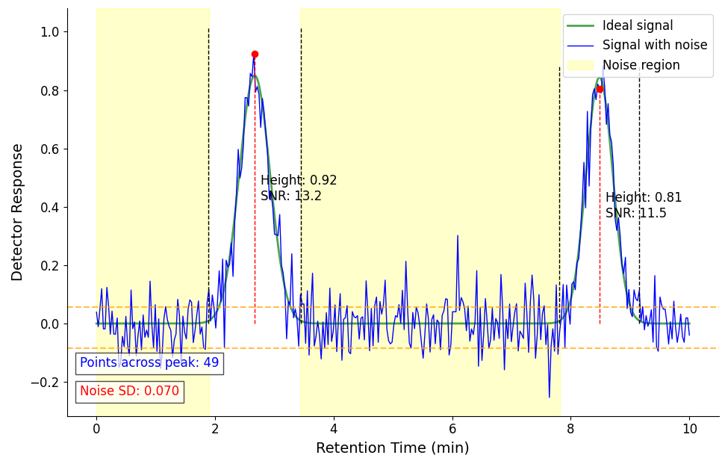
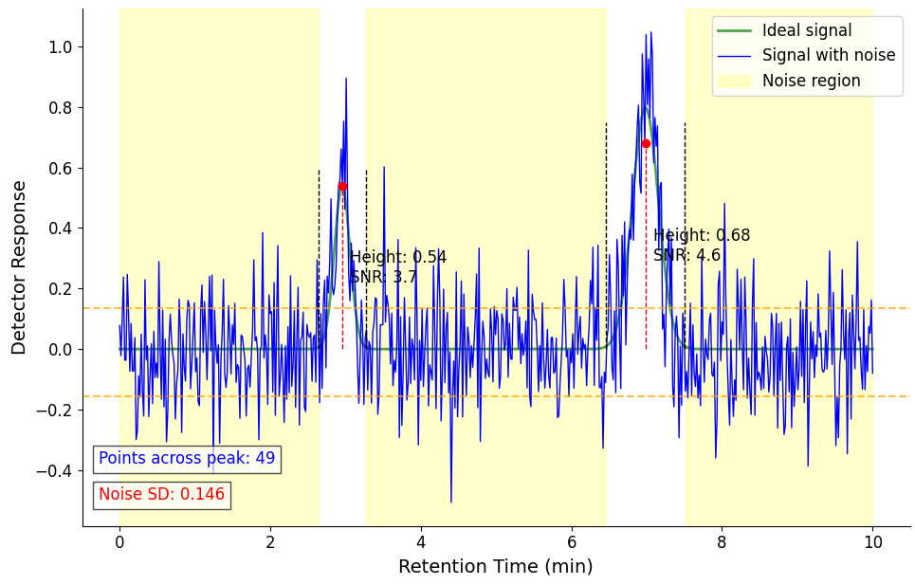
Common way to calculate S/N of a peak

Slide 19
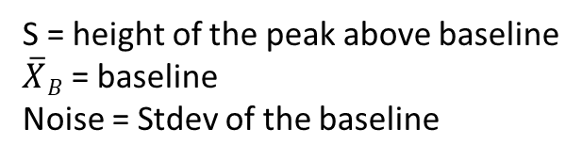
Ways to express Signal to Noise?
Most Common Way
What is wrong with this?
Signal to Baseline Noise
S = height of the peak above baseline
$\overline{X}B$ = baseline
Noise = Stdev of the baseline

Slide 20
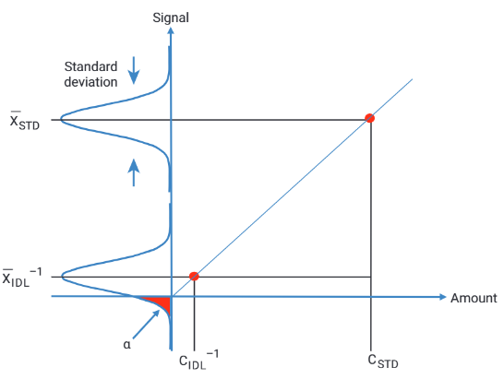

Slide 21
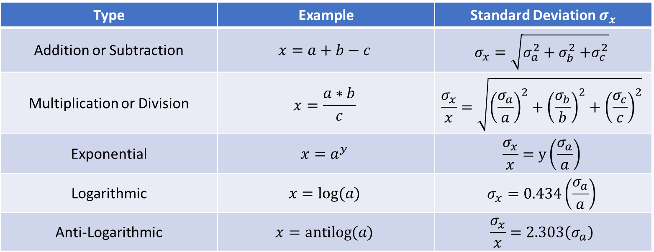
Propagation of Error
Type | Example | Standard Deviation $σ_{x}$
Addition or Subtraction | $$x=a+b−c$$ | $$σ_{x}=\sqrt{σ_{a}^{2}+σ_{b}^{2}{+σ}_{c}^{2}}$$
Multiplication or Division | $$x=\frac{a∗b}{c}$$ | $$\frac{σ_{x}}{x}=\sqrt{{\left(\frac{σ_{a}}{a}\right)}^{2}+{\left(\frac{σ_{b}}{b}\right)}^{2}+{\left(\frac{σ_{c}}{c}\right)}^{2}}$$
Exponential | $$x=a^{y}$$ | $$\frac{σ_{x}}{x}=y\left(\frac{σ_{a}}{a}\right)$$
Logarithmic | $$x=log⁡(a)$$ | $$σ_{x}=0.434\left(\frac{σ_{a}}{a}\right)$$
Anti-Logarithmic | $$x=antilog⁡(a)$$ | $$\frac{σ_{x}}{x}=2.303\left(σ_{a}\right)$$
Where a, b, c are measured variables from an experiment and $σ_{a}$, $σ_{b}$, and $σ_{c}$ are the standard deviations.

Slide 22
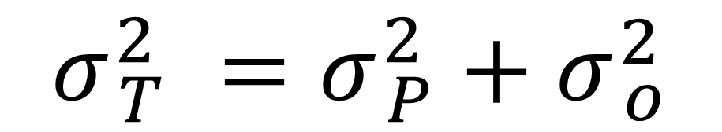
What sort of noise source is dominant?
$$σ_{ T}^{2} =σ_{ P}^{2}+σ_{ o}^{2}$$

Slide 23
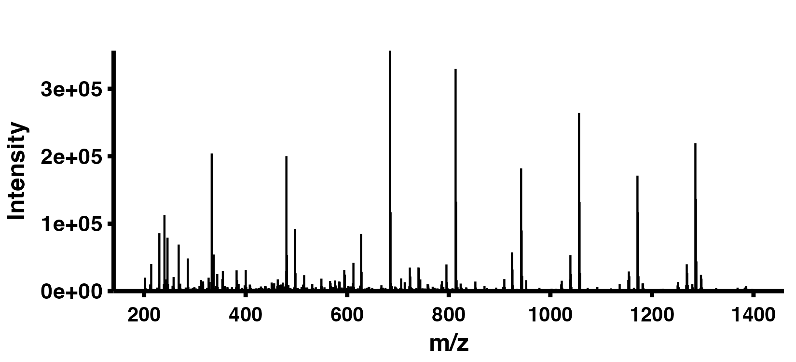
Glu1-fib peptide fragmentation pattern
y6
y7
y9
y3
y11
y4
y8
y10

Slide 24
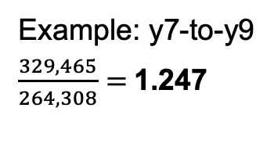
Calculating the ratio of highest y-ion intensities to y9 ion
Example: y7-to-y9
$\frac{329,465}{264,308}=$1.247
y6
y7
y9
y3
y11
y4
y8
y10

Slide 25
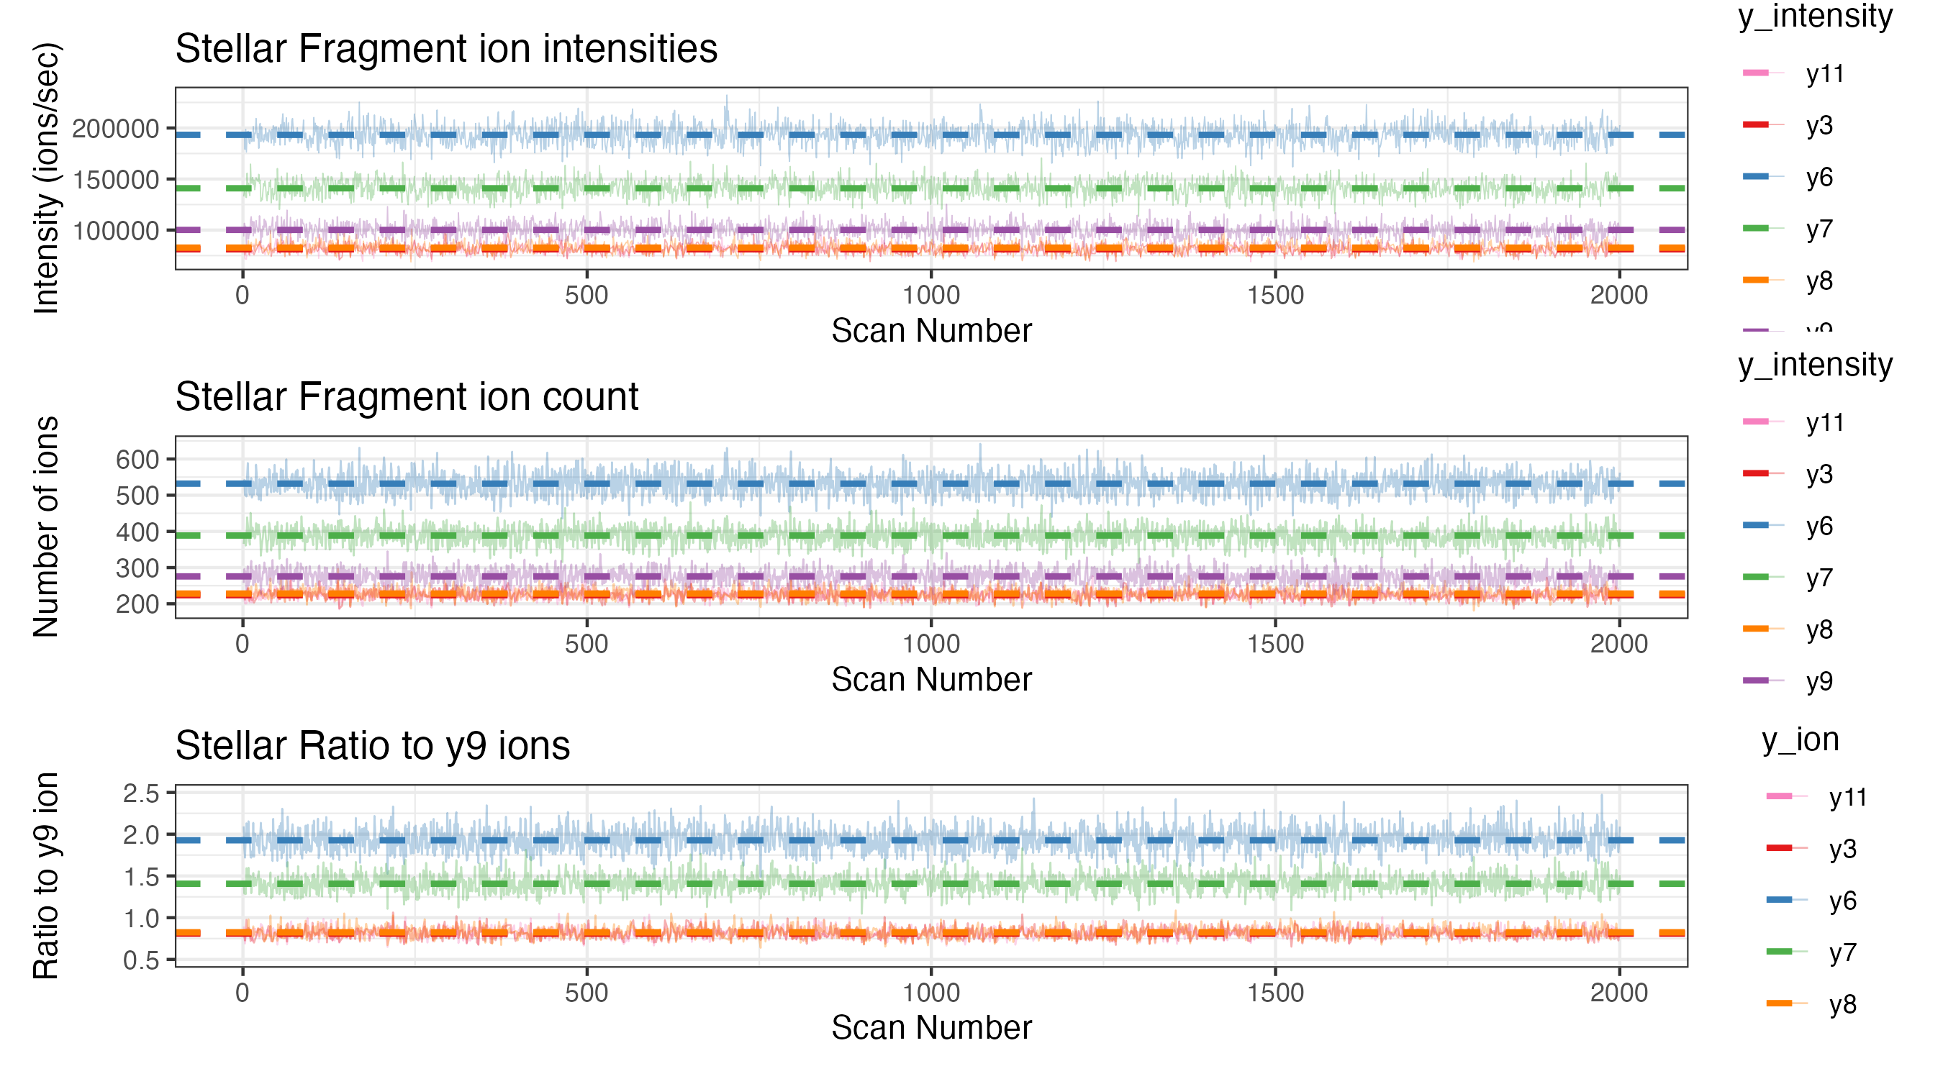
Calculate ratios across 2,000 replicate spectra
Using an intra-spectrum ratio minimizes non-poisson noise effects (i.e. electrospray)

Slide 26
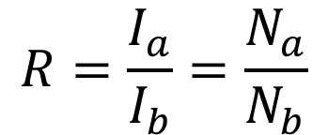
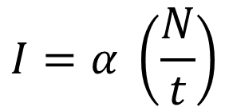
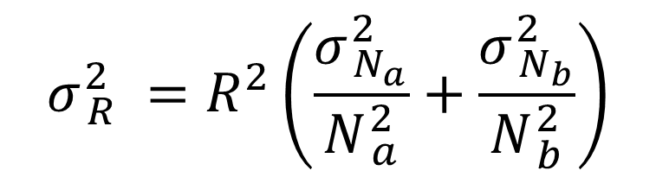
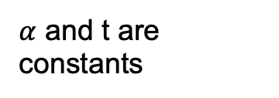
Derivation
MacCoss et al, Anal Chem (2001)
Canterbury, JASMS (2014)
Schwartz, Patent 7,109,474 (2004)
Ratio between two signals
Number of ions
Peak area of fragment ion
$$I=α \left(\frac{N}{t}\right)$$
$$R=\frac{I_{a}}{I_{b}}=\frac{N_{a}}{N_{b}}$$
$α$ and t are constants
Fit parameter
Injection time
$$σ_{ R}^{2} =R^{2}\left(\frac{σ_{ N_{a}}^{2}}{N_{ a}^{2}}+\frac{σ_{ N_{b}}^{2}}{N_{ b}^{2}}\right)$$
Propagation of errors to calculate the error in the ratio

Slide 27
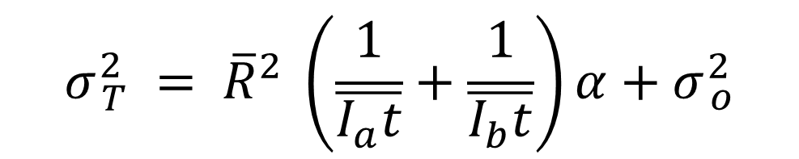
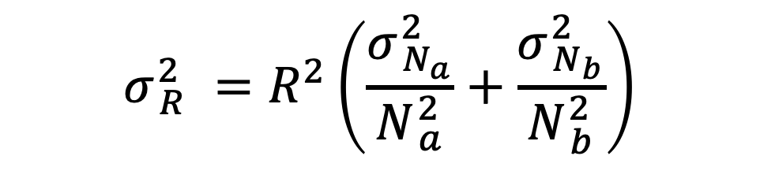
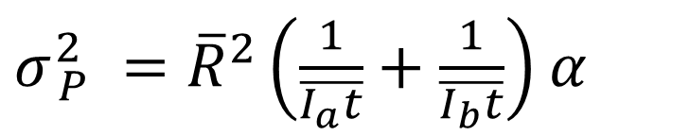
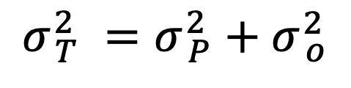
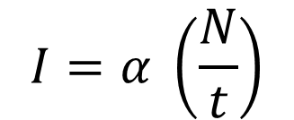


Derivation
MacCoss et al, Anal Chem (2001)
Canterbury, JASMS (2014)
Schwartz, Patent 7,109,474 (2004)
$$σ_{ T}^{2} = {\overline{R}}^{2} \left(\frac{1}{\overline{I_{a}t}}+\frac{1}{\overline{I_{b}t}}\right)α+σ_{ o}^{2}$$
$$σ_{ R}^{2} =R^{2}\left(\frac{σ_{ N_{a}}^{2}}{N_{ a}^{2}}+\frac{σ_{ N_{b}}^{2}}{N_{ b}^{2}}\right)$$
Simplify, assuming
$$σ_{ }^{2}=N$$
variance due to all other noise sources
variance due to Poisson (shot) noise
$$σ_{ P}^{2} =R^{2}\left(\frac{1}{N_{a}}+\frac{1}{N_{b}}\right)$$
total variance in a repeated measurement
$$σ_{ T}^{2} =σ_{ P}^{2}+σ_{ o}^{2}$$
$σ_{ P}^{2} ={\overline{R}}^{2}\left(\frac{1}{\overline{I_{a}t}}+\frac{1}{\overline{I_{b}t}}\right)$ $α$
$$I=α \left(\frac{N}{t}\right)$$
Peak area equation

Slide 28


Formula to determine calibration (ions/sec)
A = area of fragment peak
t = injection time
ratio of peak areas
variance in the ratio of peak areas
Calibration factor
Signal Independent noise
$$σ_{ T}^{2} = {\overline{R}}^{2} \left(\frac{1}{\overline{I_{a}t}}+\frac{1}{\overline{I_{b}t}}\right)α+σ_{ o}^{2}$$
$$y= mx + b$$
MacCoss et al, Anal Chem (2001)
Canterbury, JASMS (2014)

Slide 29



Calibration plots for Astral, Stellar, and Orbitrap
Chris Hsu

Slide 30


Other sources of noise?
Chemical noise (aka interference)
Interactions with other molecules in:
Sample
Room
Environmental noise
Frequencies that are picked up by RF detection electronics

Slide 31
Common Examples:
Dolby noise reduction: perform FFT, remove high frequency portion of the spectrum, inverse FFT
Noise cancelling headphones: A microphone records what is happening outside and the exact opposite frequency is applied to cancel those sounds out.

Slide 32

Precision vs Accuracy
Precision is about taking multiple attempts—such as shots, guesses, or measurements—and having all of them end up very close to each other.
Accuracy is about having your attempts land at the true or desired location.

Slide 33
Problem:
You have two methods for making a measurement and they give different results.
How do you assess if there is a bias?
Any systematic error that could distort the accuracy of the research findings
Sometimes a new method is developed, and we need to compare the new method with the existing one regarded as a “reference method”.
Frequently, however, we cannot regard either method as giving the true value of the quantity being measured
"Do the two methods of measurement agree sufficiently closely?"

Slide 34

What does this tell you?
Altman and Bland, The Statistician 1983

Slide 35

Bland-Altman Plot
Altman and Bland, The Statistician 1983

Slide 36


Assess if there is a bias
Left ventricular ejection fraction plotted to Illustrate Bias
Altman and Bland, The Statistician 1983

Slide 37


Measurement Error Simulation
https://claude.site/artifacts/2e700dd0-43c8-4b19-9be7-971e9d190360
Notes:
With Bias but equal random error

Slide 38


Measurement Error Simulation
Notes:
No systematic error. Differences in the Random error (this last part isn’t visible.

